Slide 1


TERM PROJECT
Nutrition Coach: A Multimodal Indian Food Nutrition System
Student Name : Student ID : Email ID : Programme : Course Code : Course Name : Trimester :
Vanshi Sethi
23035010020
s.vanshi@op.iitg.ac.in
BSc. (Hons.) Data Science & AI
DA 378
Internship-2/Term Project-2
VIII
Indian Institute of TechnologyGuwahati
BSc. (Hons.) Data Science & Artificial Intelligence Online Degree Programme

Slide 2
Agenda
Problem Context: The challenge of dietary tracking for Indian cuisine.
Our Solution: Nutrition Coach System Overview.
Dataset & Preprocessing: Merging standalone and composite meal data.
Methodology: YOLOv8 Detection, Nutrition DB, & Recommendation Engine.
Conclusion: Detection metrics & pipeline evaluation.
Demo : Code repository and live demonstration.

Slide 3
The Problem – Why Indian Food is Hard for AI
The Health Crisis: Rising rates of diabetes, hypertension, and obesity in India directly linked to dietary habits.
The App Gap: Existing nutrition apps (e.g., MyFitnessPal) are generic and need to add calories and portions manually.
The Indian Food Challenge:
Composite Meals ('Thalis'): A single plate contains 5-7 overlapping, interacting food items (e.g., dal, rice, roti, sabzi, raita).
Data Scarcity: No large-scale public dataset exists with both bounding-box annotations and verified Indian nutritional data.

Slide 4
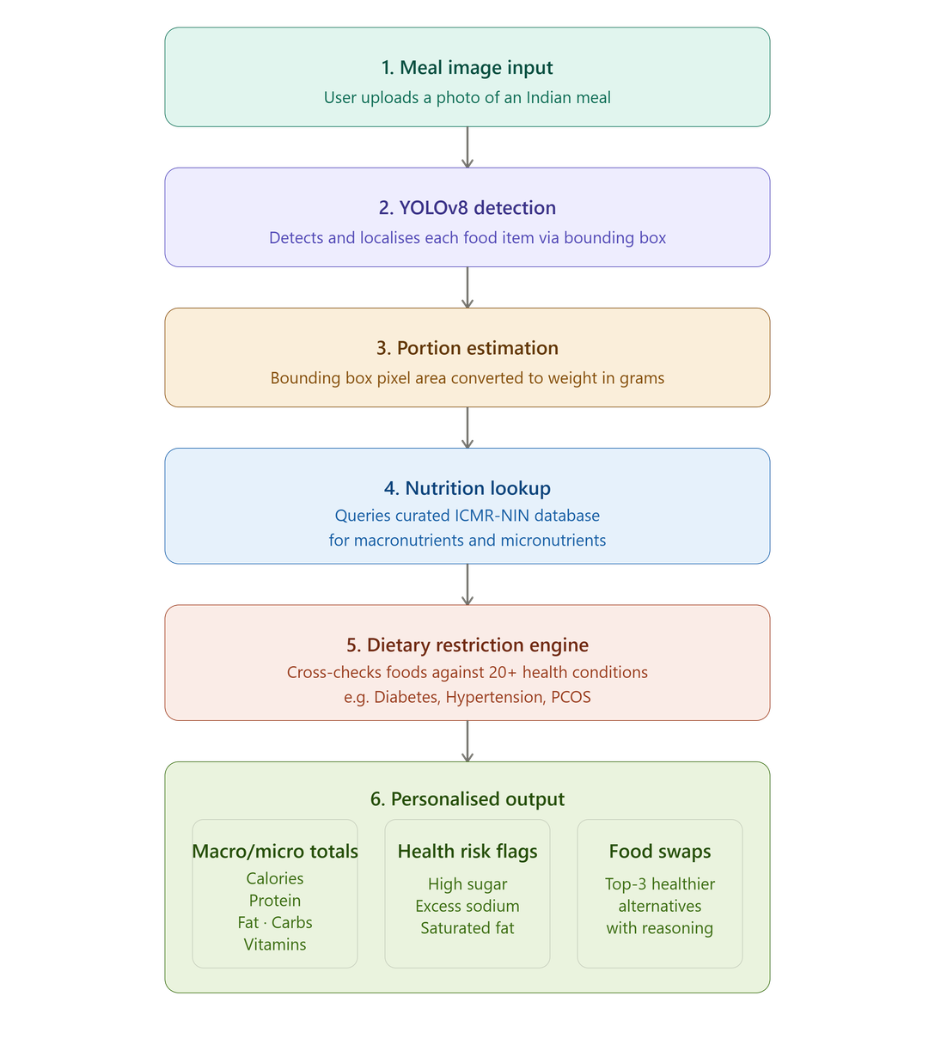
Our Solution – System Architecture
Input: User uploads a photo of an Indian meal (Thali or standalone).
Detection (YOLOv8): Model detects and localizes each food item (e.g., "Gulab Jamun" at x,y coordinates).
Portion Estimation: Bounding box area is converted to an approximate portion weight (grams).
Nutrition Lookup: System queries a curated ICMR-NIN based database for macros & micros.
Restriction Engine: Checks detected items against 20+ health conditions (e.g., Diabetes, Hypertension).
Output: User receives:
Total Calories, Protein, Fat, Carbs.
Health risk flags (e.g., "High sugar detected for Diabetes").
Top-3 healthier swap recommendations.

Slide 5

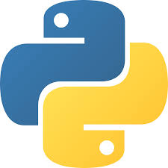



Tools & Technologies Used
Programming: Python 3.10
Deep Learning Framework: PyTorch 2.x, Ultralytics YOLOv8 (nano variant)
Environment: Google Colab (NVIDIA T4 GPU, 16GB VRAM)
Libraries:
pandas, numpy (Data processing)
Rapid fuzz (Fuzzy string matching for nutrition lookup)
Version Control: GitHub

Slide 6
Dataset – The Kaggle Rasoi Challenge
Source: Kaggle Rasoi Challenge (Public Dataset)
Structure: Two complementary subsets merged into one.
Standalone Recipes: 127 images, 55 classes (Single dish per image).
Composite Thali: 143 images, 628 bounding-box annotations, 75-85 classes (Multiple dishes per image).
Total Merged Dataset: 270 Images, 755 Total Annotations, 75-85 Unique Indian Food Classes.
Annotation Format: VGG JSON (Converted to YOLO format: cx, cy, w, h).

Slide 7
Data Preprocessing & Augmentation
Cleaning: Lowercased all class labels, stripped whitespace, standardized synonyms (e.g., "Gulab Jamun" vs "Gulabjamun").
Normalization: Converted absolute bounding box coordinates to relative YOLO format (center_x, center_y, width, height).
Class Mapping: Built a unified vocabulary of all classes by merging both subsets.
Train/Validation Split: 80% Training / 20% Validation.

Slide 8
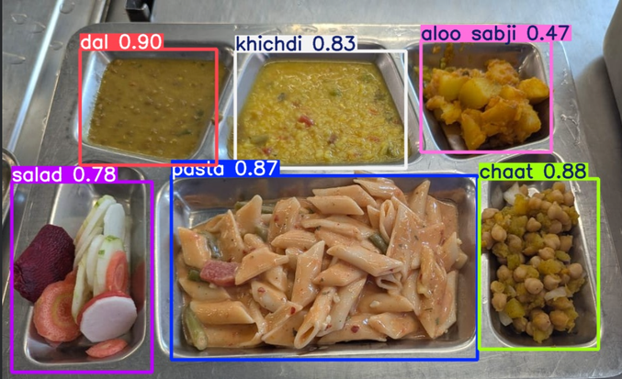
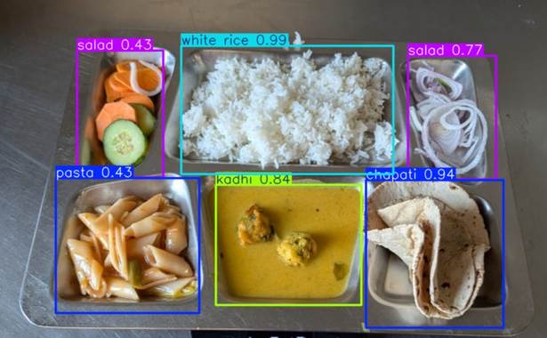
Model – YOLOv8 Fine-Tuning
Cleaning: Lowercased all class labels, stripped whitespace, standardized synonyms (e.g., "Gulab Jamun" vs "Gulabjamun").
Normalization: Converted absolute bounding box coordinates to relative YOLO format (center_x, center_y, width, height).
Class Mapping: Built a unified vocabulary of all classes by merging both subsets.
Train/Validation Split: 80% Training / 20% Validation.

Slide 9
Nutrition Database, Portion Estimation & Recommendation Engine
Nutrition Database:
Curated from ICMR-NIN (Indian national institute). Covers all food classes with macros (calories, protein, fat, carbs) and micros (sodium, fibre, sugar).
Lookup: Fuzzy string matching to handle name variations (e.g., "Aloo Gobhi" vs "Aloo Gobi").
Portion Estimation (current limitation):
Bounding-box pixel area → converted to grams using a fixed reference ratio.
Issue: Assumes pixel area = portion weight; camera distance causes 25‑35% error.
Restriction Engine:
Rule‑based dictionary mapping 20 health conditions (diabetes, hypertension, obesity, etc.) to restricted foods.
Logic: If detected food matches a restricted item for the user’s condition → flag it.
Recommendation Engine:
Weighted scoring function S(f,d) penalizes excess sugar/sodium/calories based on condition.
Output: Top‑3 healthier swaps

Slide 10
Conclusion
Key Contributions:
Merged & cleaned Indian food detection dataset.
Trained YOLOv8n model achieving 74.3% mAP@50.
Built a rule-based engine covering 20 health conditions with 100% swap improvement.
Main Takeaway: Vision-language integration is feasible for Indian diets, but portion estimation remains the primary open challenge for accurate dietary coaching.

Slide 11
Thankyou :)

